Slide 1
Course: Professional Issues in IT
Course Instructor: Shaharbano
Email address: shahar.bano@nu.edu.pk
Lec # 10

Slide 2
Management Accounting
After reading this chapter, you should, in simple cases:
be able to calculate the cost of labour;
understand the concept of overheads and the different ways in which they may be distributed;
be able to determine how much it costs to produce a particular product or provide a specific service;
understand how to produce a budget and a cash flow forecast, and how to monitor them

Slide 3
COST OF LABOUR
The cost of employing someone is more than just the cost of their salary. In most countries, employers are required to pay a tax for every employee. This tax usually goes by a name such as employers’ national insurance contribution (in the UK) or social security contribution; it is proportional to the employee’s salary. In some countries, this contribution may be as large as 60 per cent of salary, while in others it is very much smaller.
Notes:
Suppose you decide to set up a company that makes computers. The company
buys items like processor boards, memory chips, hard disks, and so on.
It then assembles the machines, installs and configures the software, and
delivers the computer to the customer. There is, in principle, no problem in
working out the cost of the components that go into the computers –
although it is only too easy to forget to add in the cost of the odd small component.
What is more difficult is working out the cost of labour

Slide 4
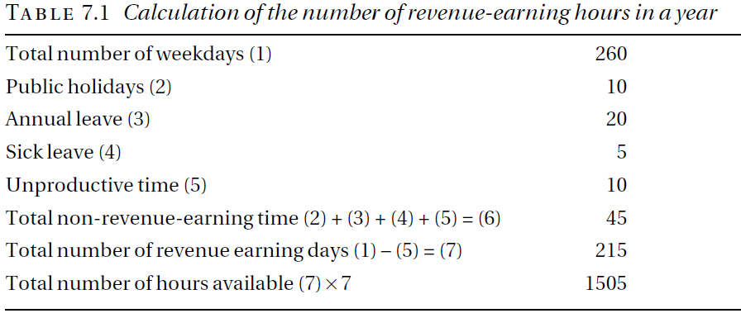
Cost of labour

Slide 5
Pay roll
The total cost of employing a person, that is, the salary plus employers’ social security contributions plus any other costs associated directly with the employee, is sometimes known as the employee’s payroll cost or direct cost.
Example :
Consider a technician who is employed to assemble the computers and suppose that he is paid an annual salary of £20,000. His payroll costs are £22,000.
The direct cost of the technician is £22,000 per year so that the direct cost of an hour of their time is £22000/1505 = £14.62.

Slide 6
OVERHEADS
Costs that cannot be directly associated with a particular product are known as overheads.
Notes:
Unfortunately, there are many costs that we have ignored. Even if our technician
works as a sole trader, with no assistance, there will be other costs he
has to pay
On the basis of the calculations above, we might reason as follows. If the components
of a computer cost £200 and it takes 10 hours of a technician’s time
to assemble the computer, install the software and configure it, then the cost
of constructing the finished product is £200 + 10 × £14.62 = £346.20.

Slide 7
Overheads
Notes:
Since we expect to sell 350 units, this means £181.43 per computer(overhead calculated from budget total over head is 63500/350 total of expected sales in table 7.4). This
means that the Basic model would cost
£181.43 + £200 + 10 × £14.62 = £527.63
The Advanced model would cost
£181.43 + £300 + 12 × £14.62 = £651.83
and the Professional model would cost
£181.43 + £400 + 15 × £14.62 = £802.23
The second way of allocating the overhead is to make it proportional to the
number of hours of labour involved. This means adding an overhead component
to the cost of an hour of a technician’s time. Since we have three technicians,
each supplying 1,505 hours of productive labour per year, we need to add
£63500/(3 × 1505) = £14.06
to the cost of an hour’s labour, making it up to £14.62 + £14.06 = £28.68. Now
the cost of the three models comes out at:
£200 + 10 × £28.68 = £486.80 (Basic)
£300 + 12 × £28.68 = £644.16 (Advanced)
£400 + 15 × £28.68 = £830.20 (Professional)

Slide 8
BUDGETING
A budget is a financial plan showing the expected income and expenditure for an organization over a specific period, typically one year.

Slide 9
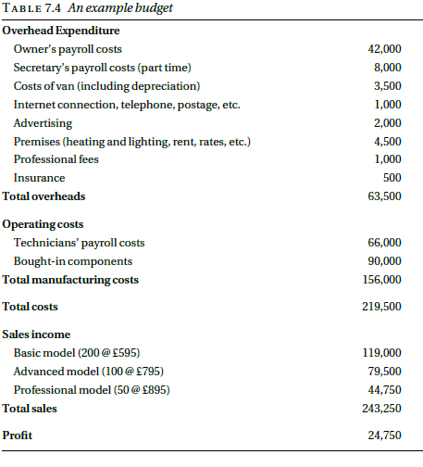
Example

Slide 10
CASH FLOW FORECAST
A company may be very profitable but unable to pay its bills. For that reason, it may be forced into receivership. This apparent paradox typically arises because bills have to be met, in particular staff have to be paid, before the income they generate is received. In order to avoid this difficulty businesses need to prepare cash flow forecasts, that is, estimates of the amount of money that will flow into and out of the company each month.

Slide 11
Example Question
Employees of Syniad Software plc work a five day week. They are entitled to 20 days holiday a year in addition to public holidays. On average, each employee loses 10 working days per year through sickness. Syniad aims to allow each employee 15 days per year for training. Experience shows that employees spend an average
of five days a year unproductively, as a result of scheduling
problems. In accordance with government regulations, employers must pay social security contributions equal to 6 per cent of salary.
Calculate the average direct cost of one day’s work from an
employee earning £20,000 per year. State explicitly any assumptions you make.
9422,3815,3860,3903, 3822,3803

